Slide 1
Overview
When working with scholarly data, the analyst must consider many different technology aspects. In terms of data integration, knowledge of the available datasets and how to link across them is crucial. For effective data enrichment, experience with widely used libraries and APIs can add additional value to the data. Finally, visualization of the outcomes is essential for proper interpretation and communication of findings.
For this presentation, I will demonstrate several technology solutions relating to these import steps showing how Python, open-source libraries and public data sources can be used effectively for custom analysis. In particular, topic modelling and geoparsing will be discussed, along with network visualization using Gephi.

Slide 2
Methods and Tools for Scholarly Data Analytics
Working with Scholarly APIs: A NISO Training Series
Dr Martin Szomszor
@martinszomszor
June 9th 2022

Slide 3
About me
2003-09 PhD & Research Fellow - University of Southampton
Automatic Data Integration, Semantic Web, Knowledge Engineering, Natural Language Processing
2009-11 Deputy Head of Centre - City eHealth Research Centre, London
Epidemic intelligence using social media
ECDC Field Epidemiology Manual Wiki
20011-18 Chief Data Scientist – Digital Science
Global Research Identifier Database (GRID) -> ROR
HEFCE Impact Case Study Database (REF2014)
Springer Nature SciGraph
2018-21 Director - Institute for Scientific Information, Clarivate
R&D for new Web of Science features including Author Impact Beam Plots, Impact Profiles, Citation Topics and the new Journal Citation Indicator
Produced the annual Highly Cited Researcher list
Various reports and academic papers on research management, bibliometrics, research integrity, emerging research fronts, etc…
2021-22 Electric Data Solutions LTD
Custom Research Analytics for institutions, funders, publishers and charities
Impact Case Study Database for Hong Kong RAE2020
Google Scholar link

Slide 4


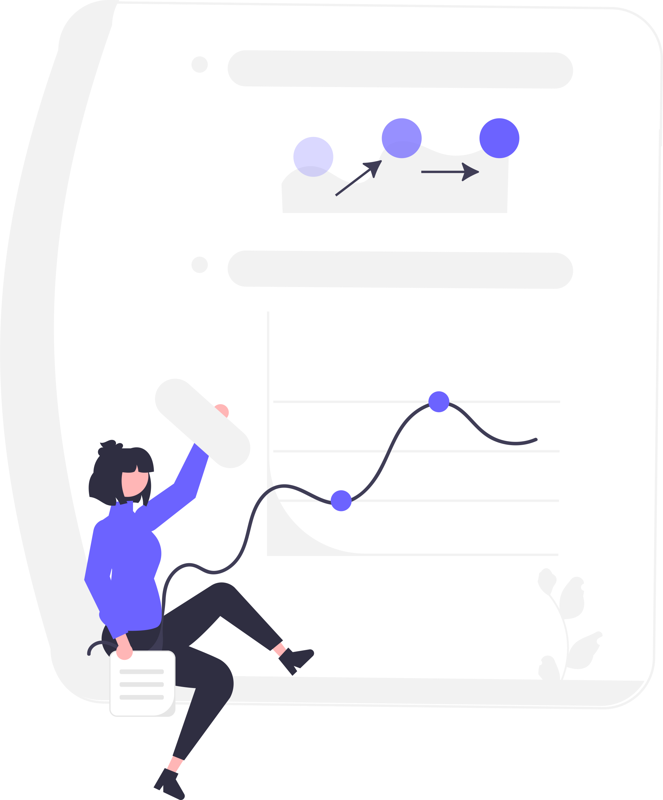
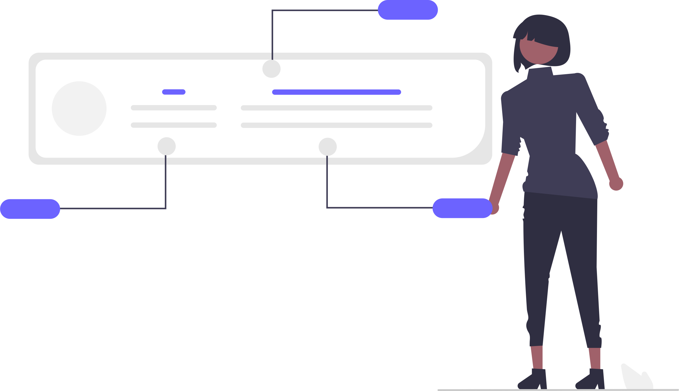
Typical Data Science workflow
Formulate Questions
Discover data sources
Link & enhance the data
Analytics
Research Topic
Funders
Collaborations
Disciplines
Journals
Open Access
Publication data
Grant award data
Patent data
Policy mentions
Impact Case Studies
Text analysis
Bibliometrics
Geoparsing
Visualizations
Metrics / Indicators

Slide 5
Data Linking
Persistent identifiers provide the best way to link data across different sources:
DOI / ISBN for scholarly works
GRID / ROR for institutions
Crossref Funder Registry for funders
ORCID for researchers
Geonames for geography
Many provide services to help disambiguate unstructured data:
Crossref Simple Text Query will find DOIs for reference text
ROR API to match author affiliations to relevant institutions

Slide 6
Data Enhancement
For many analytical scenarios, it is beneficial to integrate data from multiple taxonomies or classifications that provide complimentary views
Research may be classified using the following approaches, each of which will provide a different interpretation
Journal Classifications (Web of Science Subject Categories, Scopus All Science Journal Classification)
Article-level classification (Dimensions Fields of Research, InCites Citation Topics)
Text mining (Topic Modelling, sentiment analysis)
… and many others (OECD Frascati Manual, Funder specific taxonomies)
Choice will depend on the research question
Time-scale (e.g. is long term stability required or are more dynamic and contemporary topics required?)
Granularity (is the classification suitably broad or narrow?)
Coverage (is the data covered sufficiently well?)
Combinations may provide insights into different aspects of the research:
Journal Classifications align well with concept disciplinary origin
Custom topic models can provide more nuanced views of the research type, domain of application or beneficiary group
Bibliometric approaches are useful in the identification of research communities
Other important aspects may include
Collaboration mode (domestic versus international)
Collaborating partners (industrial, healthcare etc)
Open Access type (Gold, Hybrid, Green, etc)

Slide 7
Tutorial
To demonstrate these concepts, I have created some Python notebooks to show how data can be extracted, enhanced and analyzed
For this purpose, I have chosen the research topic “Dengue Fever”
Often categorized as a neglected tropical disease, it has growing research interest as cases continue to rise and more countries see infections
Relevant to UN Sustainable Development Goals
Includes research on many topics including climate change, socio-economic development, migration, pharmaceutical development, etc.
It is a research topic where geography is important
It is only a toy example – many crucial steps (i.e. proper search methodology and data curation) have been omitted so the results are only for illustrative purposes

Slide 8
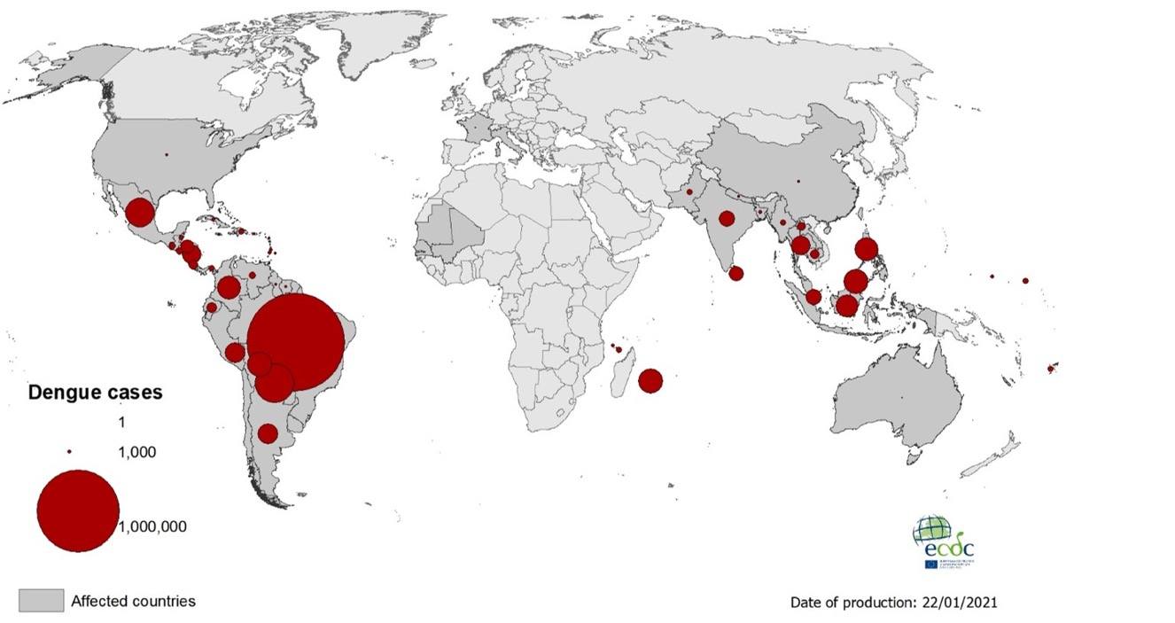
Geographical distribution of dengue cases reported worldwide, 2020
https://www.ecdc.europa.eu/en/publications-data/geographical-distribution-dengue-cases-reported-worldwide-2020

Slide 9
Technical Requirements
Code for this presentation can be found on Github:
https://github.com/martinszomszor/2022_NISO
I have also included the data files so you can play around with analysis part without reprocessing the source data
If you have Python and pip installed, you can easily install the required libraries using:
pip install –r requirements.txt
You will also need to download and extract the Edinburgh Geoparser from
https://www.ltg.ed.ac.uk/software/geoparser/
I use Gephi for network visualization, software available for Mac / Windows / Linux
https://gephi.org/

Slide 10
Python Jupyter Notebooks
These Notebooks should be executed in order to run the various step of the analysis:
01 Download Publication Data.ipynb
Use OpenAlex API to extract publications related to “Dengue Fever”
02 Geoparse.ipynb
Use the OpenSource Edinburgh Geoparser to identify locations mentioned in the title or abstract
03 Bibliographic Coupling.ipynb
Extract cited references from publication data and use bibliographic coupling to cluster related publications
Vizualise the Network using Gephi
04 Topic Modelling.ipynb
Create a simple topic model using title and abstracts
Visualize the publication dataset using UMAP
05 Analysis.ipynb
Join the data files and produce some simple analysis

Slide 11
01 Download Publication Data.ipynb
You may have a subscription to a bibliometric database, such as Web of Science, Scopus, or Dimensions, but if not, there is also the option to use OpenAlex

Slide 12
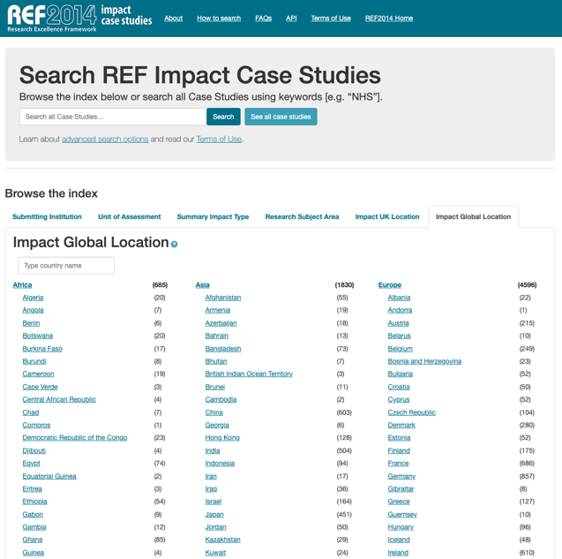
02 Geoparse.ipynb
Geoparsing – the identification and disambiguation of locations mentioned in text
Used to annotate REF2014 impact case studies with impact locations
When applied to research publications on diseases, it can help identify where studies have taken place

Slide 13
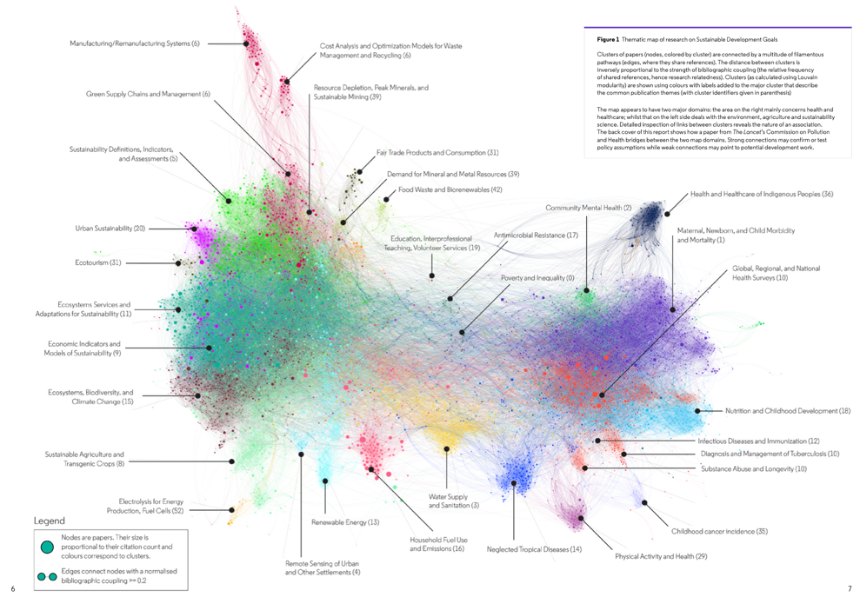
03 Bibliographic Coupling.ipynb
The citation network contains information about the nature of research publications
One common technique is to calculate publication similarity based on the overlap in cited works (bibliographic coupling)
This image is taken from an ISI report on UN SDGs

Slide 14
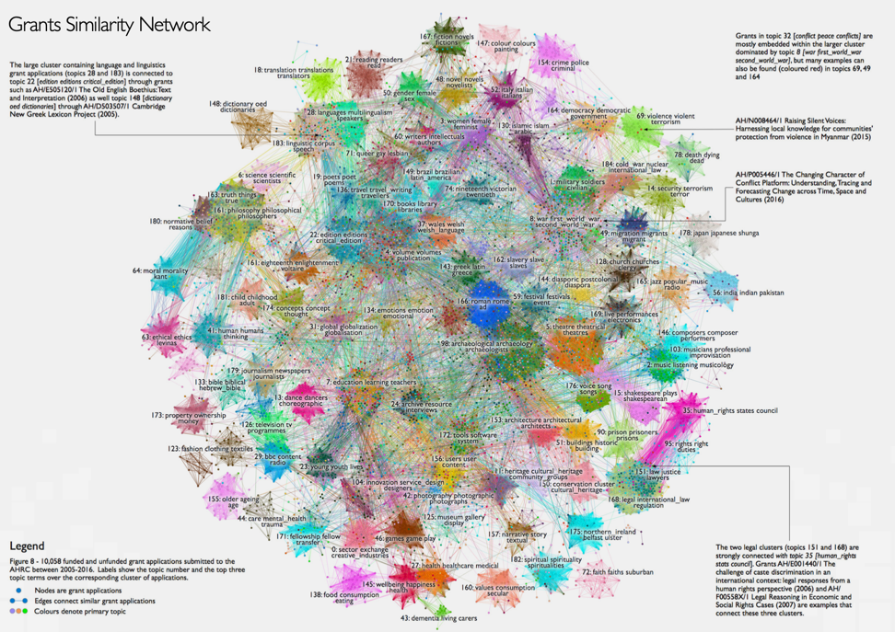
04 Topic Modelling.ipynb
Topic modelling is a natural language processing (NLP) technique that determines how certain clusters of related words (topics) can be used to categorise the underlying data.
It is a data driven approach, meaning results are not dependent on pre-conceived notions of structure, but are instead derived from the data itself
This image from a 2017 report shows Arts & Humanities research grants and their various topics

Slide 15
05 Analysis.ipynb
How frequently are locations mentioned in research relating to Dengue Fever?
Is research focused in areas with increased incidence?
Do certain locations have more or less research on a particular topic?
Are publications that mention certain countries authored by researches based on those countries?

Slide 16
Final remarks
There are many public data sources that can be linked with scholarly data to provide new analytical opportunities
World Bank
World Health Organization
European Union Open Data Portal
UNICEF Datasets
Data Science techniques, such as Geoparsing and Topic Modelling, can be used to enhance scholarly data and provide insights to research questions

Slide 17
Thanks for your attention
martin@electricdata.solutions
Find out more at electricdata.solutions

